Slide 1
Logic foundation Study
2018-01-17
Jason

Slide 2
From 0 to understand the following concepts
Semantics
Logic
Logic form
Valid inference
Syntax
Statement
Sentence
Argument
Interpretation
Validity
Soundness
Completeness

Slide 3
Why we study the semantic in LR?
Pick out implicit or hidden info behind the world
Referential theory
Sense
Truth-making of sentence
Listener-Speaker mode in enterprise community
Multiple truths of perspective & co-existing
Identification
Identify object based on extension & intension
Eliminate ambiguity
Portable in cloud computing
Symbolization
Reflection

Slide 4
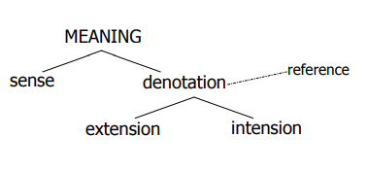
The foundation of semantics
Semantics: Study of meaning between listener and speaker
What does “Meaning” mean?
To what extent is it a linguistic matter?
What kind of theory of meaning is best suited to the linguistic facts?
First of all, two views of meaning:
Mentalistic Theory - Focuses on how expressions map to concepts
Referential Theory - Focuses on how expressions map to world
Truth-conditional semantics is based in a kind of ‘referential theory’ (or extensional theory) of meaning
Problem? function words?/non-existent ‘entities’/ same extension, different concept/verbs/ambiguity
Secondly, let’s classify the following concepts and relationship
Meaning
Sense
Reference(denotation)
Extension
Intension

Slide 5
Theory of meaning
Reference
Sense

Slide 6
Speaker’s Meaning vs. Sentence Meaning
Speaker’s Meaning vs. Sentence Meaning
SENTENCE MEANING (or WORD MEANING): what a sentence (or word) means, i.e. what it counts as the equivalent of in the language concerned.
SPEAKER’S MEANING: what a speaker means (i.e. intends to convey) when he uses a piece of language.
Truth-conditions
Knowing the meaning of a sentence is knowing its truth conditions.
Every sentence has a truth value, which indicates whether a sentence is true or false in a given situation.

Slide 7
Kinds of Meaning
Kinds of meaning – Let’s take dog as example: definition of dog
domesticated,
four-legged carnivorous mammal of the species canis familiaris !
Two kinds of definition here:
listing essential properties – domesticated, four-legged carnivorous mammal
assigns an entity to a class or classes
properties determine relationships between linguistic expressions
stating membership of a class - of the species canis familiaris
Therefore, we have “two sides of the same coin” about the Meaning
Sense - The relationships between expressions within the language
Reference(denotation) - The entity / class of entities that an expression picks out

Slide 8
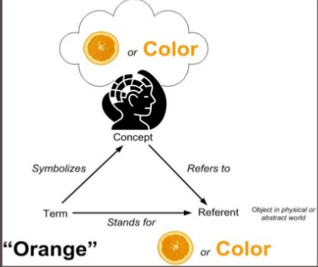
Meaning: Sense and Denotation
Sense and Denotation
Sense: deals with relationship inside the language
Abstract, without reference to the world
Denotation: The entity / class of entities that an expression picks out
The real object in the world
The broader the denotation, the fewer detailed sense relations
animal : broader denotation, less detailed sense
dog : narrower denotation, more detailed sense
For example,
What’s the orange’s meaning?
e-bank1
Sense: the abstract concept beyond the object
Reference: the object in world
Host1 provides cpu2
host1 provides cpu1
goals
shares
Identifies host
Identifies cpu
host1 provides cpu1
Sense: a orange vs Reference: the orange
Denotation
Sense in ecosystem

Slide 9
Sense and Meaning
Sense of an expression = its sense property + sense relations with other expression.
Sense Property
Analytic – An analytic sentence is one that is necessarily TRUE, as a result of the sense of the words in it. It reflects a tacit agreement by speakers of the language about the sense of the words in it.
For example, all CPUs are VNA– The truth of this sentence follows from the senses of the CPU and VNA.
Synthesis – A synthetic sentence is one which is NOT analytic, but maybe TRUE or FALSE depending on the way the world is(situation)
For example, cpu1 enables task1 – its truth depending on the situation instead of the sense of cpu and task
Contradiction – is a sentence that is necessarily FALSE, as a result of the sense of the worlds in it. It’s the opposite of an analytic sentence.
For example, Host is Storage is a contradiction – it must be FALSE cause the sense of Host and Storage
Sense relation
synonymy, antonymy, hyponymy

Slide 10
Denotation and Reference
Reference occurs in context, as a result of using referring expressions
my dog : used to refer to a particular dog
Denotation can be used (also) for what other expressions pick out, independently of context
dog : denotes the class of dogs

Slide 11
Reference and Meaning
Referring Expressions: a specific referent is picked out
I want that cookie.
Non-Referring Expressions: a generic interpretation
I want a dessert. I don’t know what, just anything

Slide 12
Extension and Intension
Extension: sometimes equated with denotation, but contrasts with…
Intension:
The defining property of an expression
E.g. the ‘dogginess’ of dog, the ‘redness’ of red, the ‘runningness’ of run, etc.
Extensional and intensional denotation
Pick out entities or classes of entities
Pick out a defining property
Defining property - This isn’t obviously ‘something in the world’, like a concept.
Intensions determine extensions

Slide 13
Extension and Intension to Identify Things
Extension (the extension of a term/symbol is the set of entities which it denotes) | Identify two different dogs by the dog’s extension. E.g. Labrador, poodle, bulldog, etc.
Intension (A set of properties shared by all members of extensions) | Identify Cat and Dog by defining its property. Dog: a domesticated carnivorous mammal that typically has a long snout, an acute sense of smell, and a barking, howling, or whining voice Cat: a small domesticated carnivorous mammal with soft fur, a short snout, and retractile claws

Slide 14
Predicate
Predicates denote properties. Extensionally, this means sets
If predicates are sets, predication is locating an entity in a set. Important thinking
Definition: A predicate is any word(or sequence of words) which(in a given single sense) can function as the predicator of a sentence
Why – identifies elements in the language system
A word can be ambiguous(more than one sense), but a predicate can have only one sense.
What
the degree of a predicate
One-place predicate : CPU(Most Nouns), Dead(Adjectives), …
Two-place predicate : IO, provides, enables, consumes, …
The extension of a predicate
A complete set of all things which could potentially be the referent of a referring expression whose head constituent is that predicate.
How
Prototype: A prototype of a predicate is an object which is held to be very TYPICAL of the kind of object which can be referred to by an expression containing the predicate
Extension of one-place predicate is the set of all individuals to which that predicate can truthfully be applied
E.g. the extension of CPU is the set of all CPUs; What’s the prototype of a MAN?
Stereotype: the stereotype of a predicate is the list of the typical characteristic of the predicate.
E.g. the stereotype of elephants is a list of characteristic which describes the prototype.
Notes:
Prototype capture the way that our minds adapt to the similarity of things in the world.
Clustering is a typical prototype. It refers to a set of nodes by a typical feature within these nodes.
We can classify one object based on its similarity to the prototype
Why prototype?
Categories normally not definable in terms of necessary and sufficient features.

Slide 15
Categorization
What?
Identification: two or more perceptually distinct objects are classified as being the same thing
Why?
Greatly reduce learning and memory requirements
Enables us to efficiently order and relate objects and events
Provides probability-based information
Allows for quicker decisions about most appropriate way to act in novel situation
Allow us to make assumption about the missing details
How?
Rigid definition
Satisfy both the Necessary and Sufficient conditions
Necessary: In order to be member of X, an object must have feature Y.
Sufficient: If an object has feature X, then it must be a member of Category of Y.
Category membership determined on basis of essential features
Prototype theory & Stereotype theory

Slide 16
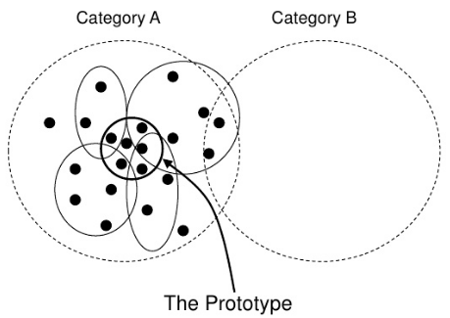
Prototype theory
Why?
What’s the GAME? Generally necessary that all games be amusing, but not sufficient since many things are amusing.
Sometimes, categories normally not definable in term of necessary and sufficient features
Have no clear boundaries
What?
Prototype: the most typical member of a category
Shares the most features with members of its own category
Shares the fewest features with members of other categories
Certain members of a category are prototypical – or instantiate the prototype
Categories form around prototypes; New members added on basis of resemblance to prototype
No requirement that a property or set of properties be shared by all members
Features/attribute are gradable(graded structure)
Notes:
Problem:

Slide 17
Stereotype theory
Speakers of a language have in their heads:
An idea of the bare sense of any given predicate
A stereotype of it
Stereotype of a predicate: is a list of the TYPICAL characteristics or features of things to which the predicate may be applied.
The stereotype of an elephant is a list of characteristics which describes prototype.
Prototype determines Stereotype
The stereotype of a predicate may often specify a range of possibilities.
A speaker may know a stereotype for some predicate.

Slide 18
Predicate and Argument
As mentioned above, “If predicates are sets, predication is locating an entity in a set’
John runs
John is in the set of running things
The kettle is broken
The kettle is in the set of broken things
The boy is a genius
The boy is in the set of things (people) that are geniuses

Slide 19
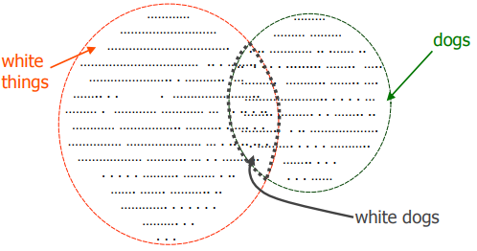
Set theory and Extension
We can now use mathematical set theory to understand how meaning is built up compositionally:
predication is the relation ‘is a member of’
complex predicates can be interpreted as set intersections:
a white dog ` one of the members of the intersection of the set of white things and things that are dogs’

Slide 20
Extension and The Undecidability
Extension: is the complete set of all things which can potentially be the referent of a referring expression whose head constituent is that predicate
Undecidability : The basic flaw in the essential idea of extension
Even people who claim to know the meaning of chicken, but it can’t draw a clear line around the set of all chickens, past, current and future, separating them from all the non-chickens. Therefore, the extension of chicken is “undecidable” (fuzzy set)
The existence of perfectly clearly defined sets of things in a large number of cases ->It’s implausible to postulate.
E.g. the set of all tables

Slide 21
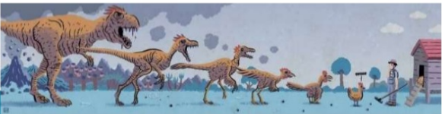

Chicken & Egg problem
The extension of chicken is not clear set. It’s a fuzzy set.
Even one people who claim to know the meaning of chicken, but it still can’t draw a clear line around the set of all chickens, past, present and future, separating them from all the non-chickens
What’s the extension of chicken?
Which comes first?

Slide 22
What’s logic? - A general understanding firstly
Logic is generally held to consist of the systematic study of the form of valid inference.
What’s valid?
A valid inference is one where there is a specific relation of logical support between the assumptions of the inference and its conclusion.
The logical form of a sentence or set of sentences, such as a proposition, statement or truthbearer, is the form obtained by abstracting from the subject matter of its content terms or by regarding the content terms as mere placeholders or blanks on a form. In an ideal logical language, the logical form can be determined from syntax alone;
The concept of logical form is central to logic. The validity of an argument is determined by its logical form, not by its content.
Inferences are steps in reasoning, moving from premises to conclusions
Reason is the capacity for consciously making sense of things, establishing and verifying facts, applying logic, and changing or justifying practices, institutions, and beliefs based on new or existing information.
What’s syntax?
What’s argument?
But, what’s reasoning?
Notes:
https://en.wikipedia.org/wiki/Logic
https://en.wikipedia.org/wiki/Logical_form
https://en.wikipedia.org/wiki/Inference
https://en.wikipedia.org/wiki/Information
https://en.wikipedia.org/wiki/Institution

Slide 23
Why we need Logic?
Problem-solving agents can’t infer unobserved information
Isolated perception -> Emergence
Multiple-perspective-of-truth in complex environment
Problem-solving agents were very inflexible: hard code every possible state
Search is almost always exponential in the number of states
We want an algorithm that reasons in a way that resembles reasoning in human
Logic can help to infer new facts from old facts using rules of inference. -> Provide evidence to prove assumptions -> Truth-making

Slide 24
Subject(Formal logic) of these concepts
Formal logic – study the validity(see later) of arguments(see later) by looking at the abstract form of arguments.
Formal logic is the study of inference with purely formal content.
Propositional logic is the branch of logic concerned with the study of propositions (whether they are true or false) that are formed by other propositions with the use of logical connectives
First-order logic is a particular formal system of logic. Its syntax involves only finite expressions as well-formed formulas, while its semantics are characterized by the limitation of all quantifiers to a fixed domain of discourse.
What’s semantics?
What’s UoD?
Notes:
https://en.wikipedia.org/wiki/Mathematical_logic#Formal_logical_systems
https://en.wikipedia.org/wiki/Logic

Slide 25
What’s the argument?
In logic and philosophy, an argument is a series of statements typically used to persuade someone of something or to present reasons for accepting a conclusion.
The general form of an argument in a natural language is that of premises (variously propositions, statements or sentences) in support of a claim: the conclusion.
In formal logic, it consists of any number of premises, and one conclusion.
2 Types of argument
A deductive argument asserts that the truth of the conclusion is a logical consequence of the premises.
An inductive argument, on the other hand, asserts that the truth of the conclusion is supported to some degree of probability by the premises.
What’s statement?
What’s sentence?
Notes:
https://en.wikipedia.org/wiki/Argument

Slide 26
What’s the logic consequence?
Logical consequence (also entailment) is a fundamental concept in logic, which describes the relationship between statements that hold true when one statement logically follows from one or more statements.
A valid logical argument is one in which the conclusion is entailed by the pre mises, because the conclusion is the consequence of the premises.
A sentence is said to be a logical consequence of a set of sentences, for a given language, if and only if, using only logic (i.e. without regard to any personal interpretations of the sentences) the sentence must be true if every sentence in the set is true
Notes:
https://en.wikipedia.org/wiki/Logical_consequence

Slide 27
Before the statement and sentence understanding, let’s study the syntax firstly.

Slide 28
Syntax first- What’s the Syntax in formal logic?
In linguistic: syntax - the set of rules, principles, and processes that govern the structure of sentences in a given language, specifically word order and punctuation.
In Logic: syntax - refers to the rules governing the behavior of mathematical systems.
Rules: man-made principles, in general, they come from physical world and guide human to understand the physical world.
For example, the syntax
In nature language: Subject – Predicate(Verb) – Object
In propositional logic: A^B |- A (^elimination), A, A->B |- B(->Elimination),…
Notes:
Reference
https://en.wikipedia.org/wiki/Syntax
https://en.wikipedia.org/wiki/Universal_grammar

Slide 29
Syntax in formal logic
If the syntax is formalized, then it’s independent on the physical world.
No semantics (What’s the semantics? - See later)
For example
Both “I play basketball” and “basketball play me” conform to the syntax of “subject-predicate-object”, that is, right expression.
However, the latter one is obviously false in the physical world.

Slide 30
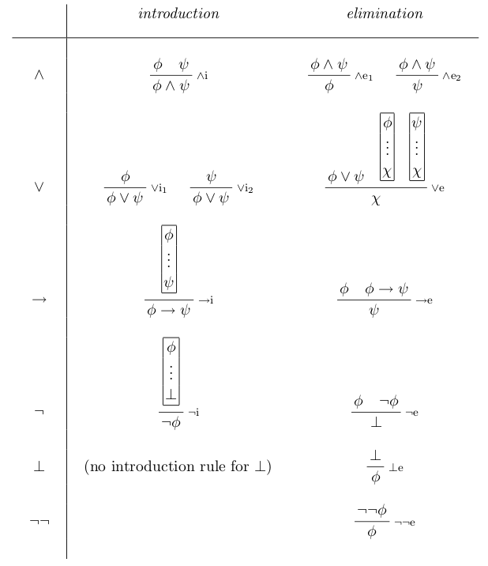
So what’s the syntax in formal logic on earth?
Take propositional logic as example
They are a set of natural deduction rules
What’s the natural deduction rules?
i.e. A^B^C |- A, where A, B and C is called the statement, which is the assertion that is made by a true or false declarative sentence(see later)
i.e.
I love movies and sports |- I love movies
Notes:
Reference:
https://en.wikipedia.org/wiki/Statement_(logic)
https://en.wikipedia.org/wiki/Sentence_(mathematical_logic)

Slide 31
So what’s the sentence in formal logic?
In logic, the term statement is variously understood to mean either:
A meaningful declarative sentence that is true or false, or
The assertion that is made by a true or false declarative sentence
Notice that: In the latter case, a statement is distinct from a sentence in that a sentence is only one formulation of a statement, whereas there may be many other formulations expressing the same statement.
So what is the sentence?
In mathematical logic, a sentence of a predicate logic is a boolean-valued well-formed formula with no free variables.
Notes:
Reference:
https://en.wikipedia.org/wiki/Statement_(logic)
https://en.wikipedia.org/wiki/Sentence_(mathematical_logic)

Slide 32
What’s the well-formed formula & formula & symbol?
In mathematical logic, propositional logic and predicate logic, a well-formed formula, abbreviated WFF or wff, often simply formula, is a finite sequence of symbols from a given alphabet that is part of a formal language.
What’s the formula?
A formula is a syntactic object that can be given a semantic meaning by means of an interpretation. Two key uses of formulas are in propositional logic and predicate logic.
What’s the symbol?
A symbol is a mark, sign, or word that indicates, signifies, or is understood as representing an idea, object, or relationship.
A logical symbol is a fundamental concept in logic, tokens of which may be marks or a configuration of marks which form a particular pattern.
Symbols of a formal language must be capable of being specified without any reference to any interpretation of them.
A symbol or string of symbols may comprise a well-formed formula if it is consistent with the formation rules of the language.
A formal symbol as used in first-order logic may be a variable (member from a universe of discourse), a constant, a function (mapping to another member of universe) or a predicate (mapping to T/F).
Notes:
https://en.wikipedia.org/wiki/Well-formed_formula
https://en.wikipedia.org/wiki/Symbol

Slide 33
So what’s the syntax in formal logic?
In the left syntax of propositional logic
φ ∧ ψ φ ψ —— ∧ e₁ , —— ∧i ,
φ φ ∧ ψ
where φ , ψ is the formula as we described above
∧ e₁ refers to Elimination, it eliminates ∧ from φ ∧ ψ
∧ i refers to introduction, it introduces ∧ from φ and ψ
Graph 1: propositional logic syntax
Notes:
Reference:
https://en.wikipedia.org/wiki/Statement_(logic)
https://en.wikipedia.org/wiki/Sentence_(mathematical_logic)

Slide 34
So what’s the syntax in formal logic?
In these syntax rules, we only know these φ, ψ are statement with true or false.
However, these rules are right in syntax level whatever their real truth in physical world. That is, form is independent with physical world.
For example,
Φ=“I can run” , ψ=“I will fly”, within rule “->e” , it infers that “I will fly” since “I can do run”, but it’s obviously ridiculous in physical world.
Notes:
Reference:
https://en.wikipedia.org/wiki/Statement_(logic)
https://en.wikipedia.org/wiki/Sentence_(mathematical_logic)

Slide 35
What’s the Inference in more detail?
Inferences are steps in reasoning, moving from premises to conclusions.
Reasoning is associated with thinking, cognition, and intellect.
The philosophical field of logic studies ways in which humans reason formally through argument.
A premise is a statement that an argument claims will induce or justify a conclusion.^{[3]} In other words, a premise is an assumption that something is true.
A conclusion is the second half of a hypothetical proposition
An Inference example
Whatever now!
φ₁,φ₂,…,φ_{n} |- ψ
Premises
Conclusion
Notes:
https://en.wikipedia.org/wiki/Inference
https://en.wikipedia.org/wiki/Logical_consequence
https://en.wikipedia.org/wiki/Consequent

Slide 36
What’s the valid inference? - Validity
In logic, an argument is valid if and only if it takes a form that makes it impossible for the premise to be true and the conclusion nevertheless to be false.
A formula is valid if and only if it is true under every interpretation, and an argument form (or schema) is valid if and only if every argument of that logical form is valid.
An argument is valid if and only if the truth of its premises entails the truth of its conclusion and each step, sub-argument, or logical operation in the argument is valid
No matter how the universe might be constructed, both the following arguments is valid
The following arguments is invalid！
Given:
P = All men are mortal.
Φ = Socrates is a man.
Q = Socrates is mortal.
Argument:
P, Φ |- Q
Given:
P = All cups are green.
Φ = Socrates is a cup.
Q = Socrates is green.
Argument:
P, Φ |- Q
Given:
P = All men are immortal.
Φ = Socrates is a man.
Q = Socrates is motal.
Argument:
P, Φ |- Q
In conclusion, the validity of argument indicates that we can infer the conclusion from the premises only with the natural deduction rules.
Notes:
https://en.wikipedia.org/wiki/Validity

Slide 37
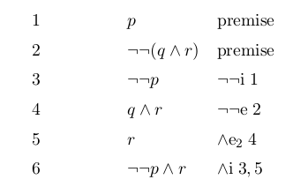
How to decide if an argument is valid?
Q: If the following argument valid?
p, ¬¬(q ∧ r) |- ¬¬ p ∧ r
A:The Proof is just used to decide if the conclusion can be inferred from the premises based on the rules of inference:
A formal proof or derivation is a finite sequence of sentences , each of which is an axiom, an assumption, or follows from the preceding sentences in the sequence by a rule of inference.
This is the proof procedure based on elimination and introduction rules in PL
Notes:
https://en.wikipedia.org/wiki/Mathematical_proof
https://en.wikipedia.org/wiki/Proof_theory
https://en.wikipedia.org/wiki/Formal_proof
https://en.wikipedia.org/wiki/Proof_(truth)

Slide 38
Until now, we are focusing on the syntax level of formal logic to discuss these concepts, now let’s enter into the semantic level.

Slide 39
What’s the semantic?
Meaning is the information or concepts that a sender intends to convey, or does convey, in communication with a receiver
Semantics - study of meaning
what the symbol stands for
The relationship between words and its referents
Semantics is the study of how meaning is conveyed through signs and language
Semantics of logic – study of the semantics, or interpretations, of formal languages
An interpretation is an assignment of meaning to the symbols of a formal language.
A formal language is a set of strings of symbols together with a set of rules that are specific to it.
Notes:
https://en.wikipedia.org/wiki/Semantics
https://en.wikipedia.org/wiki/Meaning_(linguistics)
https://en.wikipedia.org/wiki/Interpretation_(logic)

Slide 40
What’s the semantic in natural language?
Q: What’s the semantic of the sentence “I eat food”?
Q:We know the meaning of “I eat food” because we know what’s the meaning of I, eat and food respectively.
Q:What’s the meaning of I, eat and food?
A: Firstly, we know the syntactical structure of sentence: Subject-Verb-Object
A: Besides, we also know the UoD of subject, verb, object:
I ∈{I, you, food, book, dog, … }; eat ∈{eat, drink, love, sing, …}; food ∈ {I, you, food, book, dog, … };
The meaning of sentence ∈ { the meaning of I eat food, the meaning of I love dog, …}
A: There are some mapping between “I eat food” and “the meaning of I eat food”
A: Therefore, when I say “I eat food”, you will map it into “the meaning of I eat food” to give your interpret. Perhaps, you interpret it with “the meaning of I love dog” in a wrong mapping.

Slide 41
What’s the semantic in natural language?
Q:Why we can say “I eat food”?
A: Because we have natural language and we know the syntax of the sentence: subject – verb -object
A: Besides, we also know the UoD of subject, verb, object:
I ∈{I, you, food, book, dog, … }; eat ∈{eat, drink, love, sing, …}; food ∈ {I, you, food, book, dog, … };
A: Therefore, we can say the sentence “I eat food” based on s-v-o syntax. Any interpreter can interpret its meaning by its UoD mapping.

Slide 42
What’s the semantic in propositional logic?
Q:What’s the syntax of PL?
A: φ, φ ∧ ψ, P->Q, P v Q, etc.
Q: Why they are not sentence?
A: Since we have no UoD for these formula φ, ψ, P, Q .
Therefore, if we assign the UoD:{ true , false} to these formula, then we can construct the PL sentences:
T ∧ F, T ∨ T , (T ∧ F ) v T , F ∧ F v T, T → F, F->T->T, …
Meanwhile, the meaning of all PL sentences can be defined in UoD:{true, false } too.
Q: How to define a semantic system in PL?
Notes:
In mathematical logic, we can define what’s is sentence, and the sentence structure

Slide 43
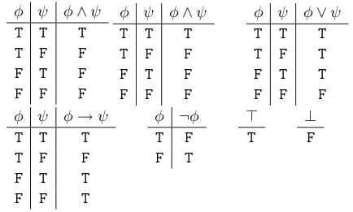
What’s the semantic in propositional logic?
Q: How to define a semantic system in PL?
A: Defining a mapping between sentence and its meaning
Q: What’s the mapping in PL?
A: The truth-table
Finally, we can know what’s the meaning of sentence T ∧ F ,F → T based on above definition.
Notes:
In mathematical logic, we can define what’s is sentence, and the sentence structure

Slide 44
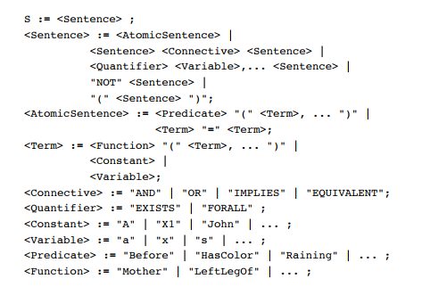
What’s the semantic in First-order logic?
Q:What’s the syntax of FOL?
Constants symbol:cpu1,dead, 2,…
Represent individuals in the world
Predicates symbol: provides, consumes, owns, =,…
map individuals to truth values
Functions symbol: stateOf, bigger-than,…
map individuals to individuals
Variables symbol: x, y, a, b,…;
Connectives symbol:^,v,~,->,⬄
Quantifiers symbol: ∃, ∀

Slide 45
What’s the semantic in First-order logic?
Q: What’s the sentence in FOL?
A: Sentences are built from terms and atoms
Q: What’s the term?
A term is a constant symbol, a variable symbol, or an n-place function of n terms.
x and f(x1, ..., xn) are terms, where each xi is a term. A term with no variables is a ground term
Q: What’s the atom?
An atom (which has value true or false) is either an n-place predicate of n terms, or, ¬P, PvQ, P^Q, P->Q, P<->Q, where P and Q are atoms
For example,
Provides (host1, cpu1)
predicate
constant
constant
term
Atomic sentence

Slide 46
What’s the semantic in First-order logic?
So what’s the semantic in FOL?
FOL sentences are true or false with respect to models, which consist of – a universe of discourse(also universe or domain), abbr. UoD
is the set of entities over which certain variables of interest in some formal treatment may range.
– an interpretation
An interpretation is an assignment of meaning to the symbols of a formal language.
Assigns to each – constant symbol: a domain element – predicate symbol: a relation on the domain (of appropriate arity) – function symbol: a function on the domain (of appropriate arity)
For example,
Provides (host1, cpu1)
domain
We do find out a host1 is individual of Host
And a cpu1 is individual of CPU and
host1 provides cpu1 in reality,
Therefore, the sentence is true in our model.
domain
domain
Host
CPU
CPU, Host, Memory, IO, VM, Switch, Port,…
Notes:
In mathematical logic, we can define what’s is sentence, and the sentence structure

Slide 47
What’s semantic entailment?
Logical consequence (also entailment) is a fundamental concept in logic, which describes the relationship between statements that hold true when one statement logically follows from one or more statements.
A sentence is said to be a logical consequence of a set of sentences, for a given language, if and only if, using only logic (i.e. without regard to any personal interpretations of the sentences) the sentence must be true if every sentence in the set is true.
Entail
φ₁, φ₂, …, φ_{n} |= ψ
Q: What’s the semantic of entailment?
A: The semantic means : If φ₁, φ₂, …, φ_{n} are all true, then ψ must be true.
Q: What’s validity of entailment φ₁, φ₂, …, φ_{n} |= ψ ?
If φ₁, φ₂, …, φ_{n} are all true, then must the ψ be true? Of course, according to the definition of entailment.
Notes:
The Polish logician Alfred Tarski identified three features of an adequate characterization of entailment: (1) The logical consequence relation relies on the logical formof the sentences, (2) The relation is a priori, i.e. it can be determined with or without regard to empirical evidence (sense experience), and (3) The logical consequence relation has a modal component.^{[3]}

Slide 48
Alfred Tarski’s definition.
The Polish logician Alfred Tarski identified three features of an adequate characterization of entailment:
(1) The logical consequence relation relies on the logical form of the sentences,
(2) The relation is a priori, i.e. it can be determined with or without regard to empirical evidence (sense experience), and
(3) The logical consequence relation has a modal component.
Notes:
The Polish logician Alfred Tarski identified three features of an adequate characterization of entailment: (1) The logical consequence relation relies on the logical formof the sentences, (2) The relation is a priori, i.e. it can be determined with or without regard to empirical evidence (sense experience), and (3) The logical consequence relation has a modal component.^{[3]}

Slide 49
What’s the difference between inference(|-) and entailment(|=)?
vs
φ₁, φ₂, …, φ_{n} |- ψ
φ₁, φ₂, …, φ_{n} |= ψ
In syntax
In semantic

Slide 50
What’s the soundness?
In mathematical logic, a logical system has the soundness property if and only if every formula that can be proved in the system is logically valid with respect to the semantics of the system.
Soundness is notated as:
If φ₁, φ₂, …, φ_{n} |- ψ, then φ₁, φ₂, …, φ_{n} |= ψ, where |- means derivation, |= means tautological entailment.
Q: What’s the meaning of soundness?
A: If we can derive ψ from φ₁, φ₂, …, φ_{n} in syntax based on the rules of inference, then we can conclude that if φ₁, φ₂, …, φ_{n} are all true, then ψ must be true in semantic.
Notes:
https://en.wikipedia.org/wiki/Soundness

Slide 51
Why we care about the soundness?
If we can prove a formal system’s soundness is positive, then we can determine : some proofs of φ₁, φ₂, …, φ_{n} |- ψ don’t exist
For example in PL:
Q: if φ₁, φ₂, … , φ_{n} |- ψ is valid? Can we prove it in syntax if the premises and conclusions are very complicated?
A: We can prove if φ₁, φ₂, … , φ_{n} |= ψ is valid by truth-table. If we determine it’s invalid based on the truth-table, then we can assert that φ₁, φ₂, … , φ_{n} |- ψ is invalid since it contradicts with soundness.

Slide 52
What’s the completeness?
In mathematical logic and metalogic, a formal system is called complete with respect to a particular property if every formula having the property can be derived using that system, i.e. is one of its theorems; otherwise the system is said to be incomplete.
Completeness is notated as:
If φ₁, φ₂, …, φ_{n} |= ψ, then φ₁, φ₂, …, φ_{n} |- ψ, where |- means derivation, |= means entailment. - converse of soundness.
Q: What’s the meaning of completeness?
A: In a formal system, if we know φ₁, φ₂, …, φ_{n} |= ψ is valid in semantic, then we must be able to find out a proof of φ₁, φ₂, …, φ_{n} |- ψ.
Notes:
https://en.wikipedia.org/wiki/Completeness_(logic)

Slide 53
Why we care about the completeness?
If we can prove a formal system’s completeness is positive, then we can determine : some proofs of φ₁, φ₂, …, φ_{n} |- ψ must exist
Without the completeness property of formal system, even though we know φ₁, φ₂, …, φ_{n} |= ψ is valid, we still can’t determine if the proof of φ₁, φ₂, …, φ_{n} |- ψ is exist or not.
Therefore, we can avoid unnecessary work by the completeness. Meanwhile, giving a more convincible proof procedure.

Slide 54
Let’s take DeadMachine as Example to show my understanding
If agent perceived an event : dead-vm event
Obviously, deadmachine includes vm dead and host dead.
Then, it expresses the event in the formal language. Before expression, there must be some symbols and syntax:
Function symbol: hasState
Predicate symbol: owns, provides,
Constant symbol: vm1, dead/alive
Syntax: Subject-verbs-Object based on RDF
Now, the dead-vm event can be expressed as “vm1 hasState dead”
That’s a Fact in the world expressed by the sentence.
Notes:
Obviously,

Slide 55
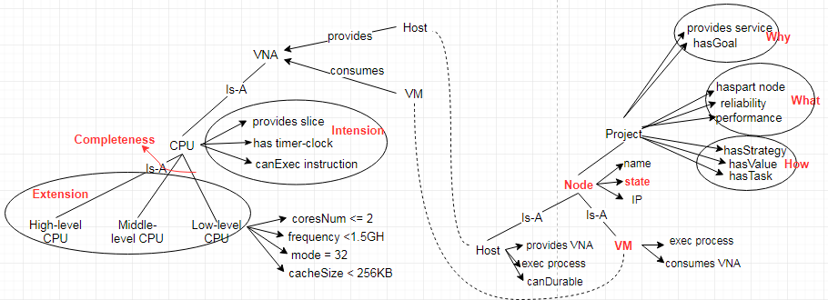
What’s the semantics of DeadMachine?
In BFO’s perspective
Within the Eco-System
……
In CPU’s perspective
In Project’s perspective
Notes:
Subsumption : superset & subset
Property: predicate & relationship between nodes
The node are arranged in a hierarchy & distance(the number of links traveled) matters
Similarity: the farther apart two things are, the less related they are.
Cognitive economy: concepts are only stored once at the highest level to which they apply
Concepts: are cluster of semantic features
Distinctive feature: core parts of concept. They must be present to be a member of the concept, they are the defining features.
Characteristic feature: typically associated with the concepts, but not necessary.

Slide 56
What can we do based on above semantic network model?
Sentence verification
Classical hierarchy model provides basis for logic & reasoning

Slide 57
Reference
https://en.wikipedia.org/wiki/Reality
https://en.wikipedia.org/wiki/Evidence
https://en.wikipedia.org/wiki/Fact
https://en.wikipedia.org/wiki/Proof_(truth)
https://en.wikipedia.org/wiki/Argument
https://en.wikipedia.org/wiki/Truth#Truth_in_logic
https://en.wikipedia.org/wiki/Semantic_theory_of_truth
https://en.wikipedia.org/wiki/Statement_(logic)
https://en.wikipedia.org/wiki/Symbol_(formal)
https://en.wikipedia.org/wiki/Sentence_(mathematical_logic)
https://en.wikipedia.org/wiki/Interpretation_(logic)
https://en.wikipedia.org/wiki/Extension_(predicate_logic)
https://en.wikipedia.org/wiki/Predicate_(mathematical_logic)
https://en.wikipedia.org/wiki/Intension
https://en.wikipedia.org/wiki/Domain_of_discourse
https://en.wikipedia.org/wiki/Hypothetical_syllogism
https://en.wikipedia.org/wiki/Disjunctive_syllogism
https://en.wikipedia.org/wiki/Completeness_(logic)

Slide 58
Assertion/Query
We want to TELL things to the KB, e.g.
TELL(KB, ∀x King(x)->Person(x))
TELL(KB, King(Jason))
These above sentences are assertions.
We also want to ASK things to the KB,
ASK(KB, ∃x Person(x))
These are queries or goals
The KB should return a list of x’s for which Person(x) is true:
{x/Jason, x/Paul, x/Jackson, …}

Slide 59
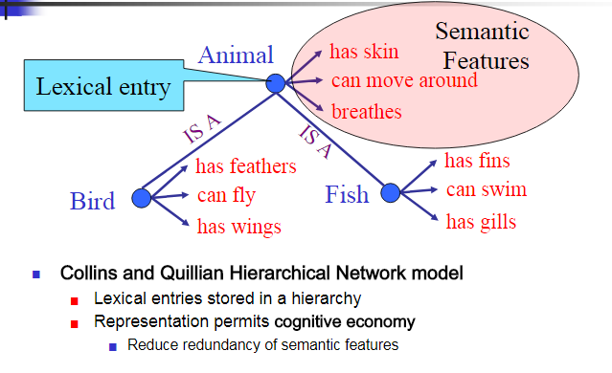
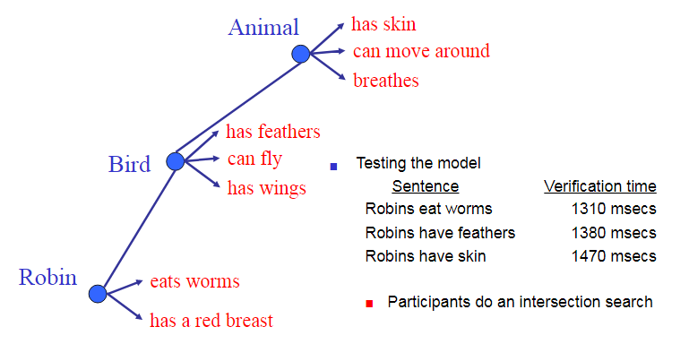
Collins and Quillian

Slide 60
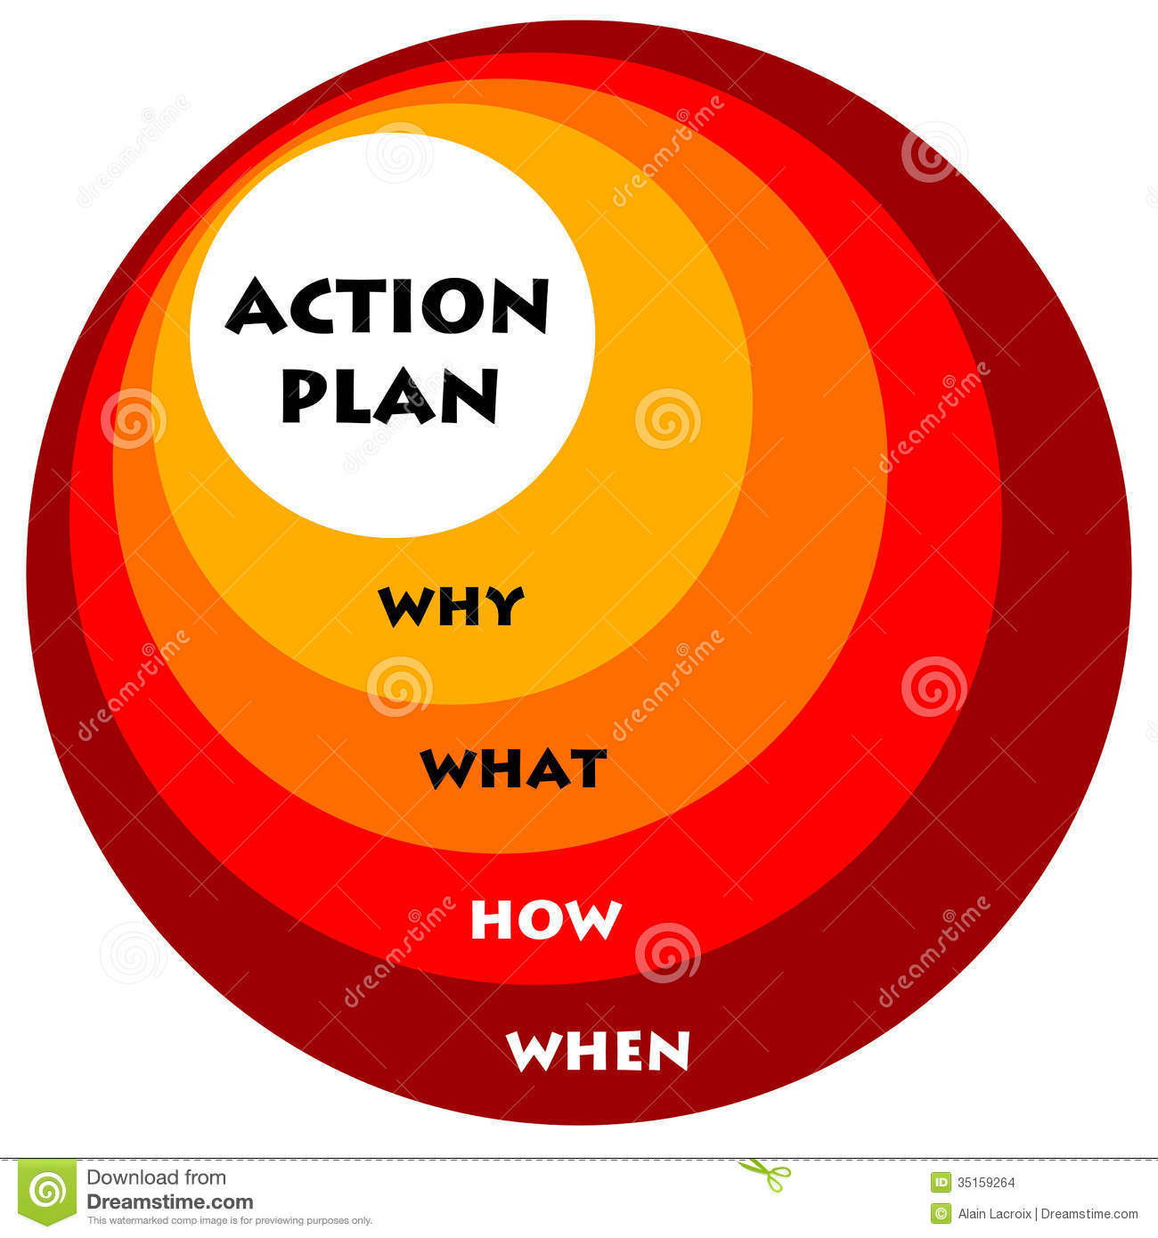
Action Planning

Slide 61
Semantic mismatch
Information comes from many autonomous sources
Differing viewpoints
Differing terms for similar items {VM, Host, Container}
Same terms for dissimilar items {}
Differing coverage
Differing granularity
Different scope
Hinders use of information from disjoint sources
Missed linkages - loss of information, opportunities
Irrelevant linkages - overload on user or application program

Slide 62
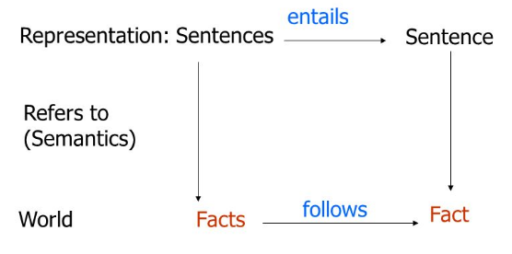
Let’s clarify some basic concepts before semantic interoperation
Fact - A fact is a statement that is true or can be proven with evidence/ truth-maker
Part of the world & scientific fact can be used to prove theory
Sentence – semantic representation of the world / truth-bearer
Machine can’t put the world into his memory -> Representation of the facts
A declarative sentence is a statement can be decided true or false.
Theory -A set of sentences in a formal language
Assumption that need to prove
Different with theorem – derived deductively from axioms(basic assumptions without need to prove)
Truth – relative to Interpretation
model theory of truth – semantic truth
proof theory of truth – syntactic truth
Truth-making & Argument – DIA logic & semantic interpretation to make truth
Priori & Posteriori – Don’t Need/Need to proof type
Notes:
In science, the term "theory" refers to "a well-substantiated explanation of some aspect of the natural world, based on a body of facts that have been repeatedly confirmedthrough observation and experiment."^{[12][13]} Theories must also meet further requirements, such as the ability to make falsifiable predictions with consistent accuracy across a broad area of scientific inquiry, and production of strong evidence in favor of the theory from multiple independent sources.
A theorem is derived deductively from axioms (basic assumptions) according to a formal system of rules, sometimes as an end in itself and sometimes as a first step toward being tested or applied in a concrete situation; theorems are said to be true in the sense that the conclusions of a theorem are logical consequences of the axioms.

Slide 63
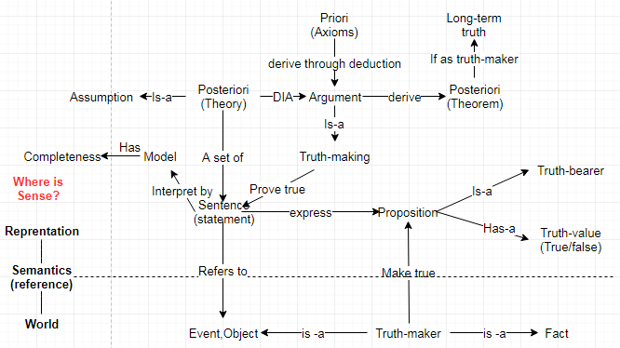
Relationship among these basic concepts

Slide 64
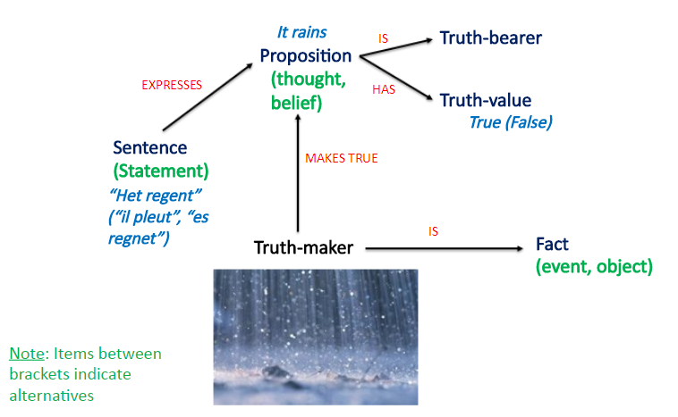
The theory of truth – Truth-maker/Truth-bearer/Truth-value

Slide 65
Why semantic interoperation?
Computability
Computability refers to whether of not in principle it is possible to evaluate f(n) by following a set of instructions.
We are not for the moment worried if this computation requires 1,000,000 or more consecutive steps.
The Entscheidungsproblem (Decision problem) asks for an algorithm that takes as input a statement of a first-order logic and answers “Yes” or “No” according to whether the statement is universally valid (valid in every structure satisfying the axioms).
An algorithm to ask whether something is true. Is it computable ?
Turing Machine & Lambda Calculus – two mathematical ways to ask question about “Computability”

Slide 66
Why semantic interoperation?
Does integration work? --Obviously, it’s impossible!
Integration problems:
Data that is available is subject to implicit assumptions which means that it can’t be reused out of context
Data is often duplicated and labelled under different items
E.g., Address vs Addr
Are there alternatives?
Direct translation
Single shared ontology
A single ontology containing representations of every term used in every application is generally considered impossible, because of the rapid creation of new terms or assignments of new meanings to old terms.
Multiple shared ontology
Notes:
https://en.wikipedia.org/wiki/Semantic_interoperability

Slide 67
Why semantic interoperation?
Does integration work? --Obviously, it’s impossible!
In theory, there are no SCIENCE linking App logic and Resource logic in computation stack
Science is based on perception, but any perception is isolated, so as the CMT and OPT.
We don’t perceive what we can’t see, obviously, human have perception limitation.
Partial information
There are no unified theory can explain everything in the world.
In practice, the integration solution limits not only the freedom of change but also the possibility of change. Enterprise can’t afford it.
Scalability – New emergent data
Security – Centralized vs Decentralized
Feasibility – Enterprise or ISP or Policy?

Slide 68
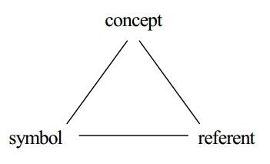
Why semantic interoperation?
Why semantic?
Human-machine interface problem
Semantic is human-facing property(depends on human’s brain) – Implicit
Semantic can be portable in cloud computing era
Semantic is stable compared with syntax
Truth-making – semantic is used to making truth
What kind of sentences in what order can be asserted as truth
Cognition process
World(Phenomenon) –Isolated perception-> Referent(Fact, Object, Event, etc.) –Conceptualization-> Concept(Thought, Meaning, Sense) –Symbolization-> Symbol(Term, Sentence, Expression, Representation, Sign)
Symbolizes
Refers to
Stands for
Notes:
Big data era: How to handle these big data? Manually or machine-processable?
Unstructured data / semi-structured data -> structured data

Slide 69
Why semantic interoperation?
Why interoperation? – defining problem
Motivations – Implicit & Heterogeneity & Isolated & freedom
Implicit – motivation is implicit since it’s the sense hidden in changer’s brain
Heterogeneous domains – multiple different cause-effects -> dynamic system
Multiple truths of perspective – isolated perception
Locality freedom – local change freedom
Co-existing – WAVE & Space of possibility & Ideal world
Change is WAVE, no one force the other, but they influence each other.
SOP – refers to find out the co-existing possibility among these motivations
Ideal world – Holistic thinking & Logic proof
Notes:
Fusion – Multiple dimensions of things can cover the unknown parts

Slide 70
Why semantic interoperation?
Semantic interoperation is used to build ideal world among different motivations via the semantic technology.
Without semantic, without meaning(sense & reference), without truth
Without interoperation, without agreement(ideal world), without system property
Without semantic interoperation, without co-existing, without SOP

Slide 71
Why semantic interoperation?
The benefits of semantic interoperation:
Loose coupling architecture with no need for integration
Change freedom / scalability / security
Sharing information among heterogeneous domains
Truth-making based on multiple isolated perceptions
SOP
Finding out much more co-existing possibility by taking into account emergence
Eliminating semantic inconsistency
Holistic thinking instead of reduction
Correctness assurance – building ideal world firstly
Notes:
https://en.wikipedia.org/wiki/Consistency

Slide 72
What’s the semantic interoperation?
Semantic interoperation
What’s the semantic? – Sense & Reference
Why semantic? – Pick out the implicit/hidden information -> Motivation representation -> Cause-Effect-Theory
What’s the interoperation? – The ability to exchange & use information
Why interoperation? –Synthesis proof & Truth-making & build ideal world
(1)Build ideal world (2)Truth-making (3)Logic process
Synthetic Predicate & Scientific research
Alias: Context-builder/Build-type/Argument/Scientific research/Dancing theory

Slide 73
What’s the semantic interoperability?
Syntax->structure
Semantic->Meaning
Interoperability – IEEE Definition
Ability of two or more systems or components to exchange information and to predictably use the information that has been exchanged.
Semantic interoperability
Syntactic interoperability
Semantic interoperability is the ability of computer systems to exchange data with unambiguous, shared meaning. Semantic interoperability is a requirement to enable machine computable logic, inference, knowledge discovery, and data federation between information systems.
Syntactic interoperability is a prerequisite for semantic interoperability. Syntactic interoperability refers to the packaging and transmission mechanisms for data.
Purpose: to overcome differences in perceptions, assumptions, perspectives and meanings
Notes:
https://en.wikipedia.org/wiki/Semantic_interoperability
https://en.wikipedia.org/wiki/Interoperability
https://zh.wikipedia.org/wiki/%E4%BA%92%E6%93%8D%E4%BD%9C%E6%80%A7

Slide 74
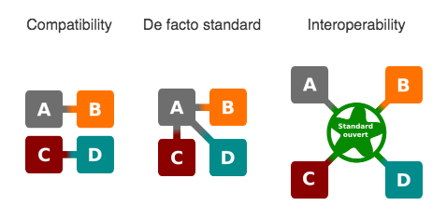
What’s not interoperability?
Compatibility
When a vendor is forced to adapt its system to a dominant system that is not based on Open standards, it is not interoperability but only compatibility.
De facto standard
The vendor behind that product can then choose to ignore any forthcoming standards and not co-operate in any standardization process at all, using its near-monopoly to insist that its product sets the de facto standard by its very market dominance.
Notes:
https://en.wikipedia.org/wiki/De_facto_standard

Slide 75
What’s not interoperability?
Integration
Tightly coupled(inter-dependent) : communication + co-operation + co-ordination
Interchangeability
replace a system or component to provide a same service with an equivalent behaviors (ex. response time)
Collaboration
has direct business mission / goal, however inter-opt is just the opposite.
directly solve some business problem, however inter-opt is just the opposite.
Portability
the ease with which a system, component, data, or user can be transferred from one hardware or software environment to another.
a quality metric that can be used to measure the effort to transport or convert the software for use in another environment
Notes:
Interoperability has the meaning of co-existence and co-operation, while integration relates to the notion of collaboration and uniformalisation.
=> Interoperability = communication + interaction
However, integration is more large and broad
=> Integration = communication + co-operation + co-ordination

Slide 76
What’s the semantic interoperation?
SOP
Sense
Cause-effect
Semantic
+
Interoperation
Reference
Co-existing
Semantic interoperation
Co-existing
Dancing
SPIME
SPIME
predicate
Isolated perception
Emergence
Isolated perception

Slide 77
Semantic interoperability
Concept1
“host1 provides 4 CPUs”
Concept2
“vm1 consumes 2 vCPUs”
Thing1
Processor:Intel-core-i7
Symbol
“CPU”
Thing2
Computation: e-bank
Concept3
“CPU usage rate < 90%”
Thing3
Operation: cpu1-config
Notes:
CPU -> processor
vCPU -> abstraction of dynamical aggregated computational resources(process)

Slide 78
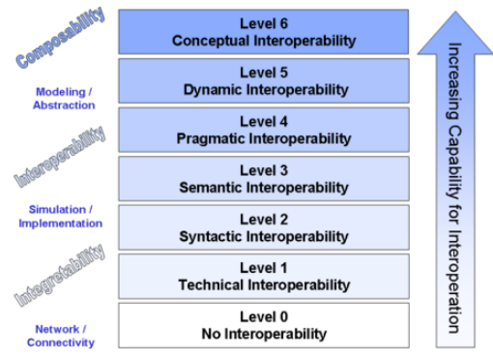
Interoperation protocol
Interoperation protocol
LCIM
Collaboration
Semantic
interoperability
Cooperation
Increasing capability for interoperation
vs
Representation
Syntactic
interoperability
Transport
SPIME 1
SPIME
2
Isolated perception
Emergence
Isolated perception
Notes:
What’s the difference between 4 layers of interoperation protocol and the Levels of conceptual interoperability?

Slide 79
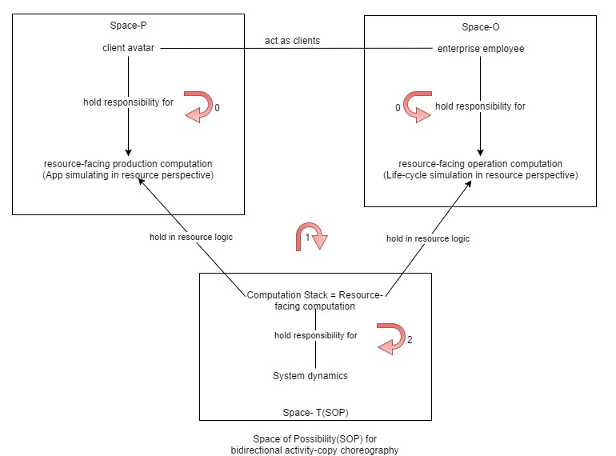
What’s the semantic interoperation in LR?
CET in CMT
CET in OPT
CET in SOP

Slide 80
What to do if semantic interoperation?
Semantic representation
Symbolization – refers to the object with the symbol
Reflection – reflect the physical world in the symbol world(semantic space)
System property –CMT & OPT co-existing by interoperating with system
Framework – Design principles independent of individuals
System motivation – conservation law
Logic – Logic as a representation of the world
Argument (logical form) to truth-making
Proof
Sense-making in a holistic way
Change is WAVE
Semantic Completeness – basis of cogent proof
Order thinking – no order, no semantic completeness

Slide 81
How to build the ideal world among different motivations?
Truth – LR’s truth
Priori(Axioms) – NO need to proof, system law as the priori
Posteriori(Theories) – need to proof
Truth-making
It’s logic proof by argument on the basis of priori & posteriori
Priori -(DIA logic)-> Posteriori
Proof what & Why? – if the emergent event/data falsify the previous theories
Do scientific research each time to prove if assumptions mismatch with the emergence
Truth need to prove every OODA loop since we assume emergence

Slide 82
How to build the ideal world among different motivations?
Key problems
How to handle the WAVE effect?
Change is wave, which spreads everywhere at the same time in the network. Emergence from wave.
When/where to start/end?
Schroedinger's Cat - Don’t know if don’t see. But we can’t see ALL.
How to see? – holistic thinking
Completeness : Logic + Semantic
Logical completeness
Can we make sure the system is safe to the change’s wave?
Are theories still true now with the emergent data?
Have we try all 21-centry theories to change the world?
Semantic completeness
How many dimensions care about the same change?
Are these multiple dimensions complete?
What will happen if some dimensions missed?
Random & Risk

Slide 83
How to build the ideal world among different motivations?
Change-WAVE
How to start?
How to stop?

Slide 84
How to build the ideal world among different motivations?

Slide 85
How machine learns a new theory?
Argument
Sense-making
Proof (DIA logic)
Negation
Long-short term real truth
Working hypothesis – short term truth
Dancing to prove what’s the truth?

Slide 86
Foundational study on the basic concepts behind LR idea
Jason
2018-3-7

Slide 87
Decidable problem
A decision problem is a problem that can be posed as a yes-no question of the input values.
A Decidable language A is decidable (recursive), if there is a Turing machine M (decider) that accepts the language A halts on every input string.
Decision
On Halt:
Turing Machine
Accept
Input
string
Decider for
Reject
Notes:
https://en.wikipedia.org/wiki/Decision_problem
I.e. 判断一个数是否是prime？ -> Decidable

Slide 88
Undecidable problem
An undecidable problem is a decision problem for which it is known to be impossible to construct a single algorithm that always leads to a correct yes-or-no answer.
Problems that a computer can’t solve
An undecidable language is not a decidable language, namely, there is no Turing machine that reaches a decision(halts) for all input strings of the language.

Slide 89
Languages vs Problems
A “language” is a set of strings
A formal language is a set of strings of finite set of symbols together with a set of rules that are specific to it.
Any “problem” can be expressed as a set of all strings that are of the form:
“<input, output>”
==> Every problem also corresponds to a language!!
e.g., Problem (a+b) ≡ Language of strings of the form { “a#b, a+b” }
Think of the language for a “problem” == a verifier for the problem
Notes:
https://en.wikipedia.org/wiki/Formal_language

Slide 90
Languages vs Problems
Any problem can be converted to a language, and vice-versa.
Problem: Determine if a number is prime
Language: L = {p : p is prime}
Problem: Determine if a Turing Machine M halts on an input string w
Language: L = {e(M), e(w): M halts on w}
Computational problem:
A function from input data to output data, more generally a relation R on data.
Data encoded as strings
Relations encoded as set of strings

Slide 91
In conclusion
Important ideas:
“problem” formalized as language
language = set of strings
“computation” formalized as simple machine
finite automata
pushdown automata
Turing Machine
“power” of machine formalized as the set of languages it recognizes

Slide 92
Turing Machine(TM)
Why Turing Machine?
To prove that certain languages have no algorithm.
What’s Turing Machine?
input tape
…
0
1
1
0
0
1
1
1
0
1
0
0
finite control
read/write head
New capabilities:
- infinite tape
- can read OR write to tape
- read/write head can move left and right
q₀
finite, non-empty
set of states
blank symbol
initial state
final states
Formal definition:
finite, non-empty set of
tape alphabet symbols
set of input
symbols
Transition function
Notes:
https://en.wikipedia.org/wiki/Turing_machine

Slide 93
Deciding and Recognizing
accept
reject
loop forever
input
machine
TM M:
L(M) is the language it recognizes
if M rejects every x ∉ L(M) it decides L
set of languages recognized by some TM is called Turing-recognizable or recursively enumerable (RE)
set of languages decided by some TM is called Turing-decidable or decidable or recursive

Slide 94
Decidability vs Undecidability
There are 2 types of TMs(based on halting):
Recursive: TMs that always halt, no matter accepting or non-accepting = Decidable problems
Recursively enumerable: TMs that are guaranteed to halt only on acceptance. If non-accepting, it may or may not halt(loop forever.).
Decidability
A decision problem A is called decidable or effectively solvable if A is a recursive set. A problem is called partially decidable, semi-decidable, solvable, or provable if A is a recursively enumerable set.
Undecidability
Undecidable problem are those that are not recursive.
Notes:
https://en.wikipedia.org/wiki/Recursive_set
https://en.wikipedia.org/wiki/Recursively_enumerable_set

Slide 95
Computability
Computability – is the problem solvable?
Computability refers to whether of not in principle it is possible to evaluate f(n) by following a set of instructions.
We are not for the moment worried if this computation requires 1,000,000 or more consecutive steps.
The Entscheidungsproblem (Decision problem) asks for an algorithm that takes as input a statement of a first-order logic and answers “Yes” or “No” according to whether the statement is universally valid (valid in every structure satisfying the axioms).
An algorithm to ask whether something is true. Is it computable ?
Turing Machine & Lambda Calculus – two mathematical ways to ask question about “Computability”

Slide 96
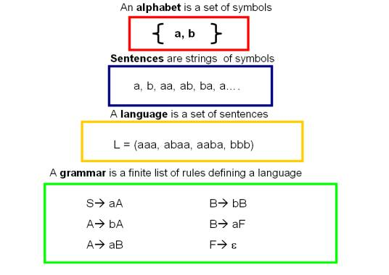
Formal language
Why formal language?
Computer-processable
Computability
What is Formal language
Well-defined
Finite set of rules
Notes:
https://en.wikipedia.org/wiki/Formal_language

Slide 97
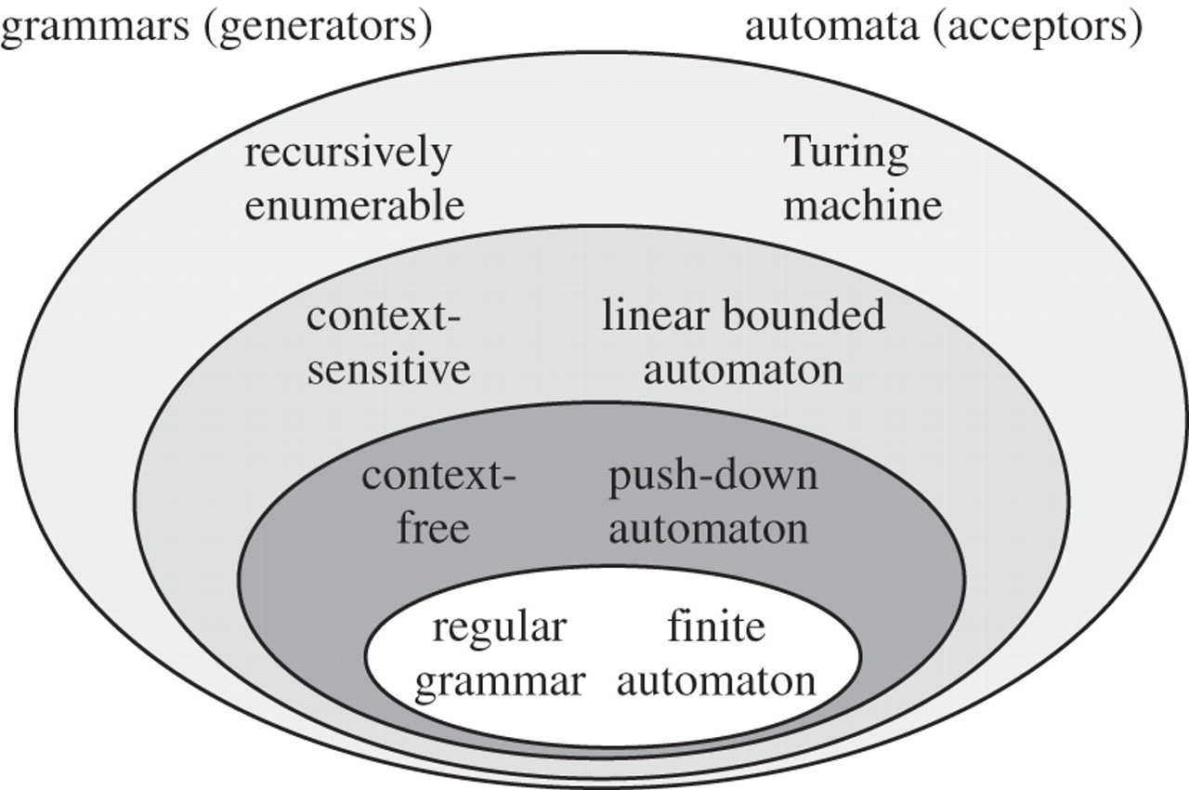
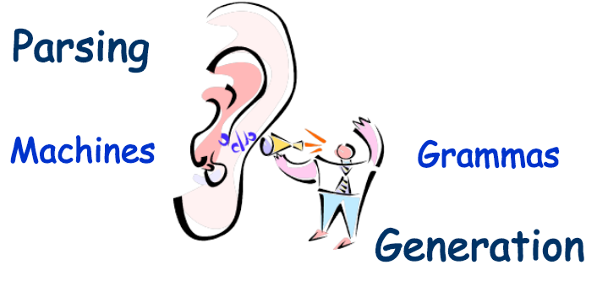
The Chomsky Hierarchy of formal Language
Study
Notes:
Semantics : listener and speaker

Slide 98
Recursive, RE, Undecidable languages
No TMs exist
TMs that always halt
LBA
Non-RE Languages (all other languages for which no TMs can be built)
TMs that may or may not halt
Context- free
(PDA)
Regular
(DFA)
Recursively Enumerable (RE)
Context
sensitive
Recursive
“Undecidable” problems
“Decidable” problems

Slide 99
Recursive Languages & Recursively Enumerable (RE) languages
Any TM for a Recursive language is going to look like this:
Any TM for a Recursively Enumerable (RE) language is going to look like this:
M
“accept”
w
“reject”
M
“accept”
w

Slide 100
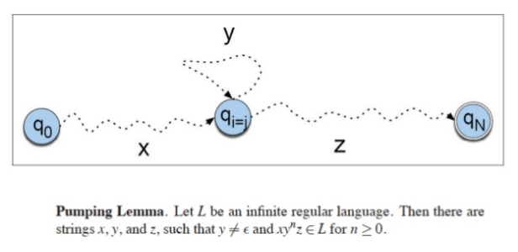
Regular language
Regular language
A regular language is a formal language that can be expressed using a regular expression
Or, a language L is regular if it’s the language accepted by some DFA
Pumping lemma
Why pumping lemma?
Determine if a language is regular language.
Notes:
https://en.wikipedia.org/wiki/Regular_language
Why regular language is not suitable for programming language?

Slide 101
Example of formal language
Regular language – only the last symbol at the right hand side can be non-terminal
E.g. P = {S → aB, B → bB, B → a} generates the language ab*a
Context-free language – only one non-terminal on the left
E.g. P = {S → aSa, S → b} generates the language a^{n}ba^{n}, n>=1
Context-sensitive language – multiple non-terminal on the left
E.g. P = {S → aSBc | abc, cB → Bc, bB → bb} generates the language a^{n}b^{n}c^{n}, n>=1

Slide 102
The relationship between Grammar, Language, Problem and Machine
Semantic
Ontology
Logical form
Represents
Language-independent
Grammar
Formal Language
Formalized by
Problem
generates
Recognizes
or accepts
Machine

Slide 103
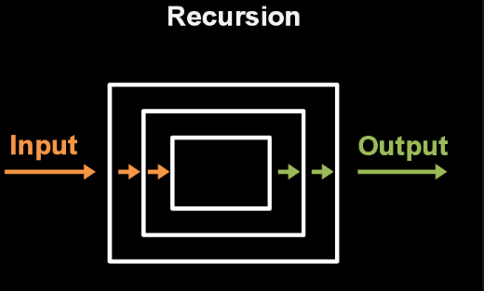
Why Recursion?
How to express the infinite sentences with finite set of rules?
The Answer is recursion
Recursion reduces the big and complex problem
into a simpler and smaller problem that easy to solve.

Slide 104
What’s the Recursion?
The recursion theorem
The rules of grammar will also need the crucial property of recursion. In this, we can put sentences inside other sentences and these sentences can be generated inside another sentences.
Notice these:
Mary helped George.
Cathy knew that Mary helped George.
John believed that Cathy knew that Mary helped George
The man [who the girl [who Peter [who knows] met] saw] is my friend.
Let T be a TM that computes fn:
T: Σ* x Σ* → Σ*
There is a TM R that computes the fn:
R: Σ* → Σ*
defined as R(w) = T(w, <R>).
Notes:
https://en.wikipedia.org/wiki/Recursion#The_recursion_theorem

Slide 105
What’s Grammar?
A formal grammar G is compact, precise mathematical definition of a language L.
Not a list of examples
Finite
Fixed
Typically use recursion to resolve infinity.
A grammar implies an algorithm that would generate all legal sentences of the language.
Often, it takes the form of a set of recursive definitions.
An example of recursive definition:
<expression> -> <expression> + 1
<expression> -> 1
{1, 1+1, 1+1+1, 1+1+1+1, …}
Notes:
https://en.wikipedia.org/wiki/Grammar

Slide 106
Basic concepts in Grammars
A → 0A1
A → B
B → #
start symbol
terminal symbols
non-terminal symbols
production
Context-Free Grammars

Slide 107
Why the grammar?
Answer two key questions:
Accepters: Is a combination of words a valid sentence in a formal language?
Generators: How can we generate the valid sentences of a formal language?
E.g. P = {S → aB, B → bB, B → a} generates the language ab*a
Grammars provide models for both natural languages and programming languages.

Slide 108
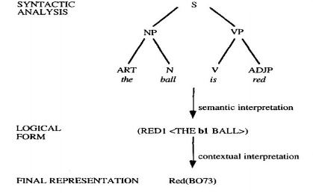
Syntax parsing
What?
Syntax parsing is the process of analyzing a string of symbols, either in natural language, formal languages or data structures, conforming to the rules of a formal grammar.
Used to determine the logical form in the formal language.
Why?
Verifying if a sentence is legal sentence based on parse tree
Code generation: transform the natural language into formal language
How?
Bottom-up: Operator-precedence parsing
Top-down: Recursive-descent parsing
Notes:
https://en.wikipedia.org/wiki/Parsing

Slide 109
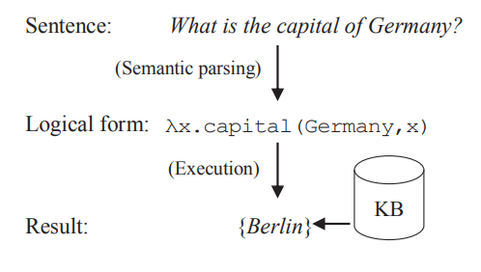
Semantic parsing
Semantic parsing is the task of converting a natural language utterance to a logical form(a machine-understandable representation of its meaning) which can be executed on a knowledge base
Process - parsing
Meaning - semantic
Formal representation – machine-understandable
Why SP? – Machine-understandable & Computable
Question Answering
Information extraction
Semantic analysis
Code generation
E.g.
Set of sentence in
a formal language
Notes:
https://en.wikipedia.org/wiki/Semantic_parsing

Slide 110
Logical form
What’s logical form?
The logical form of a sentence is the form obtained by abstracting from the subject matter of its content terms or by regarding the content terms as mere placeholders or blanks on a form.
Meaning of sentence has two aspects: 1)Meaning: context independent sense, 2)Usage: context dependent aspects
Logical form of a sentence is the context-independent meaning of the sentence
Why – To formalize natural language and reasoning; To verify if it’s a valid sentence.
Sentence rewriting based on logical form
Logical form: context-independent representation of meaning
Semantic Interpretation: mapping a sentence to its logical form
Contextual Interpretation: mapping the logical form to the final knowledge representation
Proof based on logical form
Logical form vs content
Supervised learning based on logical form
Data-driven methodology based on logical form
Notes:
https://en.wikipedia.org/wiki/Logical_form

Slide 111
4 Logical forms in LR
First-level logical form
<App, domain, domain switch, energy-meta, BFO>
Property logical form in the design time
<Env, purpose, peering, component>
Change logical form in the runtime：
<Env, top-down, bottom-up, peering>
System-level logical form:
<Rooting, predictive, undecidable, crisis>

Slide 112
Proof techniques
Axioms: statements we assume to be true, to serve as a premise or starting point for further reasoning and arguments.
Theorem: a statement that has been proved on the basis of previously established statements(such as other theorems, axioms). a theorem is a logical consequence of the axioms.
Proof: A proof is sufficient evidence or a sufficient argument for the truth of a proposition. Or, a valid argument that establishes the truth of theorem.
Lemma: a "helping theorem" is a proven proposition which is used as a stepping stone to a larger result rather than as a statement of interest by itself. In other words, a less important theorem that is helpful in the proof of other results
Corollary: theorem that can be established directly from a theorem that has been proved.
Conjecture: a conjecture is a conclusion or proposition based on incomplete information, for which no proof has been found.
Notes:
https://en.wikipedia.org/wiki/Axiom
https://en.wikipedia.org/wiki/Theorem
https://en.wikipedia.org/wiki/Proof_(truth)
https://en.wikipedia.org/wiki/Lemma_(mathematics)
https://en.wikipedia.org/wiki/Corollary
https://en.wikipedia.org/wiki/Conjecture

Slide 113
Type of Proof
Direct proof
Premise –(rule of inferences or other premises)->conclusion
For example, If p ^ q, then q; If p, then p v q, etc.
Proof by contrapositive
A direct proof but starting with the contrapositive equivalence
p->q ⬄ ~q ->~p
Proof by contradiction
Based on assumption of negation conclusion to prove contradiction
If p then q => Assume ~q –(rules of inference or a known fact)->contradiction->~q is false
Proof by case
Given a problem of the form: (p₁ v p₂ v…v p_{n}) -> q, where p₁... p_{n} are the cases.
The above form equals to [(p₁->q) ^(p₂->q)…(p_{n} -> q)], so prove all clauses are true.

Slide 114
Why Proof?
Two kinds of inferences an agent might want to make(from known to unknown):
Multiple percepts -> conclusions about the world
Current state & operator -> properties of next state
Relates to some properties of change:
Predictability
Correctness
System Consistency
In LR, we need to build the ideal world based on proof before any change in physical world.
Detecting inconsistencies
Inferring missing information(relations)

Slide 115
Space operation + Lambda-calculus
Space & Space operation
Scala space
Vector space
Function space
Lambda-operation
Alpha-equivalence/conversion : λx. x = λy. y
Beta-reduction : (λx. x) y = y, λx. λ y.(x, y) a = λ y.(a, y)
Identity : λ x. x : x => x
Self App : λ s. s s : s => s(s)
Recursion: (λ s. s s )(λ s. s s ) : (s => s(s))(s => s(s))

Slide 116
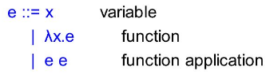
Lambda-calculus & Description Logic
What’s the λ-calculus?
λ-calculus is a formal system in mathematic logic for expressing computation based on function abstraction and application using variable binding and substitution
λ -calculus expression is defined as
Description logic(DL): subset of FOL
Representation of knowledge about categories
The set of categories in an application domain is called terminology
The terminology is arranged in a hierarchical organization called ontology, which captures superset and subset relations among categories/concepts.
The subsumption relations between the appropriate concepts in a terminology is used to specify a hierarchical structure
Subsumption is also a form of inference. Determines whether a superset/subset relation exists betw two concepts.

Slide 117
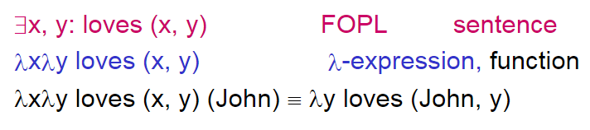
Lambda-calculus & Description Logic
Why λ-calculus?
λ-calculus: manipulation and aggregation of variables in ontology.
Why DL?
We use DL to model application domain
Decidable & Machine-processable
The relationship between λ and Ontology
λ x. λy. Near( x, y) = something near something else
λ x. λy. Near( x, y) Shanghai –reduction-> λy. Near( Shanghai, y) –reduction-> Near( Shanghai, Jiaxing)

Slide 118
Semantic – Lambda-calculus
Transform a sentence into Lambda-expression
“Shanghai is close to JiaXing”
Specific: close-to(Shanghai, JiaXing)
General: ∃ x, y : close-to(x, y) ∧ x= Shanghai ∧ y=JiaXing
λ–conversion: λ-expr – λx. λy. close-to(x, y) (Shanghai, JiaXing)
λ–reduction: λy. close-to(Shanghai, y) -> close-to(Shanghai, JiaXing)

Slide 119
Variance & Genuine proof

Slide 120
Enterprise status quo
History
Before LR
After LR

Slide 121
企业现状
企业目标通过为客户提供多样性服务，满足业务需求，进而为企业创造利润。
企业产品生命周期包括需求、设计、开发、部署、运营和下线等日常活动，企业通过以上日常活动满足不断变化的企业环境（市场需求和IT Infa），其中产品设计和运营为关键核心过程。
产品设计是直接面向客户的业务活动，为企业直接创造价值
运营是面向资源的活动，为企业计算进行交付和保障
我们认为企业计算CMT和运营OPT存在以下问题：

Slide 122
传统数据中心环境
企业CMT和OPT是两个独立过程，分属不同时空
开发设计人员在产品设计阶段产生CMT SPEC，然后交付运营人员
运营人员根据CMT SPEC需求和IT Infra现状，产生OPT SPEC并上线运行
若出现错误，则更改OPT SPEC或反馈设计人员修改CMT SPEC，继而重复如上
CMT和OPT无法观察彼此数据，只能基于假设进行SPEC设计，因此运行过程出错不可避免
业务规模增大，人力无法控制复杂性，加剧错误出现概率
该模式存在的问题
企业设计和运行阶段反复修改调试，延长产品上线时间
体现在不能快速响应市场业务变化需求，新产品无法按时交付，
企业竞争力下降
企业人员设计CMT和OPT SPEC依赖个人经验，不能抓住潜在机会
体现在企业明明有空余资源和最新技术，却无法利用
企业如何应对？
重置（Reset）：新业务上线，重置旧业务 – 应对复杂性
限制（Restrict）：人为制定配置规则，不允许修改 – 应对潜在风险
Design
time
CMT
OPT
Runtime

Slide 123
Cloud时代 + DevOps模式
在云时代，企业通过虚拟化技术池化各类资源，实现运营自动化
企业计算基于SLA订阅云服务，按需采购云资源，运营过程依赖云厂商
云服务厂商根据SLA交付企业资源，屏蔽底层资源技术细节，可在满足企业计算需求的前提下，动态自适应调整资源供应策略和技术
提升的地方：1）缩短了企业产品开发周期，Dev和Ops能够持续集成；2）CMT和OPT在同一时刻共存，在运行阶段，OPT可动态调整来满足CMT需求；3）企业的Predictability增强
该模式存在的问题：
摩尔定律在云时代失效，企业采购资源的依据不在，无法有效决策
基于Policy-network(state space)的运营策略，企业没有业务语义，无法处理emergence情况
企业产品生命周期没有数字化，机器依然无法理解CMT和OPT
企业是如何应对的？
Design
time
CMT
OPT
Runtime

Slide 124
After LR
Problems of CMT & OPT
High Predictability
Context-awareness
Build(Proof) ideal world first
Digitalization of enterprise life cycle
Low cycle period
Reset & Retry
Retry
Correctness assurance
Completeness
Correctness-by-construction
Proof theory
Design
time
OPT
CMT
Runtime

Slide 125
Building type: emergence problem
1. Type->Theory->Meta
2. Complementary
3. Negation
Genuine
(G)
1. Meta->Theory->Type->Data
2. Complementary
3. Negation
F1:
I->I
F2:
R->R
Inductive building
(Induction logic)
Deductive building
(Deduction logic)
New Genuine
(G’)
Variance1
Variance2
F3:
I->R
Emergent events
Variance3
Variance4
(5/2)
(Integer)
(Real)

Slide 126
Why cloud?
The capability(VNA) of hardware(compute, storage, network) is surplus and far outweigh the workload’s requirement
The law of hardware development is based on Moore’s law
The network bandwidth is increasing so fast
Therefore, it leads to virtualization.
Cloud is based on the virtualization
Cloud computing : KVM/Xen/…, Container, …
Cloud storage: S3, Microsoft Azure Blob, Google Drive storage, Dropbox,…
Software-defined network: Nicira,…
De-centralization

Slide 127
What’s Cloud?
On-demand service
Moore’s Law-based enterprise capability acquisition can’t work in the cloud
The importance of Semantic
Service is content about the content
Services are delivered by semantic
Ownership is changing
Before cloud(in local data-center building), enterprise employee is the content owner, which takes responsibility for the content(SW/HW)
After cloud, enterprise employee is the service owner, which takes responsibility for the service.
But who take responsibility for the whole system?
ISP or Service provider?
Virtualization
Resource pool
Portable vs single-point-of-failure

Slide 128
System
System property
Semantic interoperation
System law – conservation law as system’s motivation
Framework
System boundary – system how to classify the boundary?
1-world – Being
2-world – Essence
3-world – Notion

Slide 129
Truth and falsity
Pat is hungry.
True under some possible circumstances, false under others.
True if the “actual world” is in the “Pat is hungry” half.
Pat is hungry
Pat is not hungry

Slide 130
Truth and falsity
Pat is hungry.
Pat is sleepy.
If we know the truth value of each of these sentences, we know in which “quadrant” of the space of possible worlds we can find the “actual world.”
Pat is hungry
Pat is not hungry
Pat is sleepy
Pat is sleepy
Pat is not sleepy
Pat is not sleepy
Pat is hungry
Pat is not hungry

Slide 131
Knowledge/belief
We can use this kind of diagram to characterize what we know, our “knowledge state.”
If we know the following two things (to be true)…
Pat is not hungry.
Pat is sleepy.
…then we have narrowed down the possible worlds in which the actual world must lie
Pat is hungry
Pat is not hungry
Pat is sleepy
Pat is sleepy
Pat is not sleepy
Pat is not sleepy
Pat is hungry
Pat is not hungry

Slide 132
Assertion
We can think of assertion of a proposition as being the communication of an aspect of the speaker’s knowledge state to the hearer.
Here, both believe that Pat is not sleepy, and the speaker is asserting that Pat is hungry (about which the hearer has no prior belief).
Pat is hungry.

Slide 133
Presuppositions vs. entailments
Some utterances have a presupposition.
He had stopped stealing office supplies.
He used to steal office supplies.
My dog ate my homework.
I have a dog, and I have (er, had) homework.
This similar, but distinct from, entailment.
The emperor was assassinated.
Someone was assassinated.
The emperor died.
If p entails q, q does not follow from ¬p.
If p presupposes q, q still follows from ¬p.
That is, the presupposition of an utterance is taken as part of an “assumed background” that is not affected by the truth/falsity of the asserted proposition.
Have you stopped stealing office supplies?

Slide 134
Modeling conversation
A more sophisticated model of conversation (generally attributed to Stalnaker) involves an additional knowledge state: common ground.
The common ground is a set of shared assumptions between speakers (we might think of this as the presupposed information).
CG: Pat is either hungry or sleepy (or both). A believes Pat is sleepy but not hungry. B believes Pat is sleepy.

Slide 135
Modeling conversation
In this game, the goal is to build up the common ground.
A asserts Pat is not hungry.
B accepts this.
Pat is not hungry is added to the common ground.
Pat is not hungry.

Slide 136
Modeling conversation
So, the way the game works is that A asserts p (which might presuppose q).
B adds any presupposition q to the CG, then evaluates p, and accepts it if consistent with B’s beliefs, or rejects it if not.
Pat is not hungry.

Slide 137
Modeling conversation
In this game, the goal is to build up the common ground.
A asserts Pat is not hungry.
This is counter to B’s beliefs—B challenges this.
Pat is not hungry is not added to the common ground.
Pat is not hungry.

Slide 138
Modeling conversation
Presuppositions are acceptable if they are compatible with the common ground.
A asserts I didn’t realize that Pat is sleepy.
Presupposes: Pat is sleepy. This is compatible with the CG.
B accepts this.
A did not realize that Pat is sleepy is added to the common ground.
I didn’t realize that Pat is sleepy.

Slide 139
Accommodation
Something that presupposes something not in the common ground can be added to the common ground (accommodation).
B believes that Pat is sleepy. The CG has that Pat is sleepy.
A asserts I didn’t realize that Pat is not hungry.
Presupposes: Pat is not hungry. This is not in the CG, but isn’t contrary to it.
B adds the presupposition to the CG, and accepts it.
I didn’t realize that Pat is not hungry.

Slide 140
Presupposition failure
Something that presupposes something contrary to the common ground results in presupposition failure.
B believes that Pat is sleepy. The CG has that Pat is sleepy.
A asserts I didn’t realize that Pat is not sleepy.
Presupposes: Pat is not sleepy. This is inconsistent with the CG.
B adds the presupposition to the CG—resulting in contradiction. B cannot either accept or reject.
I didn’t realize that Pat is not sleepy.
?!

Slide 141
Common ground?
How could presupposition failure arise?
Perhaps A is simply not playing the game, but more likely, what A thinks the CG is differs from what B thinks the CG is.
Presupposition failure occurs when the interlocutors’ views of the CG get out of sync.
?!
I didn’t realize that Pat is not sleepy.

Slide 142
Algorithm definition
An algorithm is a finite sequence of step by step, discrete, unambiguous instructions for solving a particular problem
has input data, and is expected to produce output data
each instruction can be carried out in a finite amount of time in a deterministic way
Notice the term finite.
Algorithms should lead to an eventual solution.
The algorithm should stop (halt).
Sequence of steps
Each step should do one logical action.

Slide 143
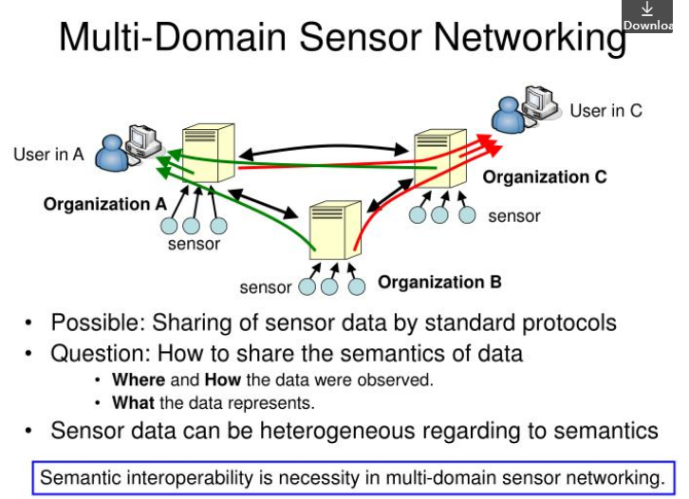

Slide 144
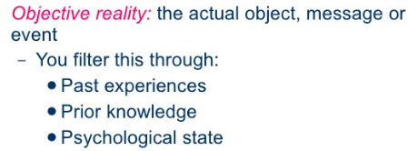
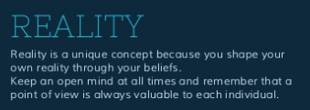
Reality

Slide 145
Background

Slide 146
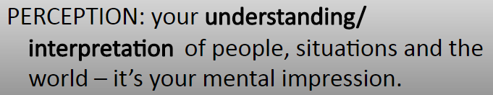
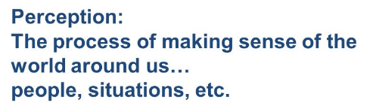
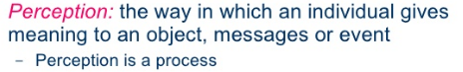
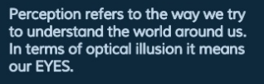
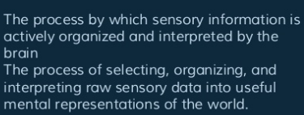
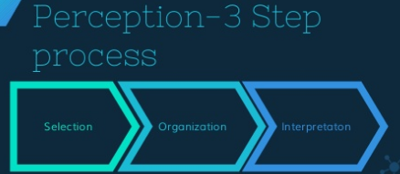
Perception(感(sensory input)+知(make sense))

Slide 147
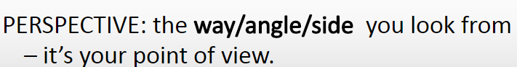
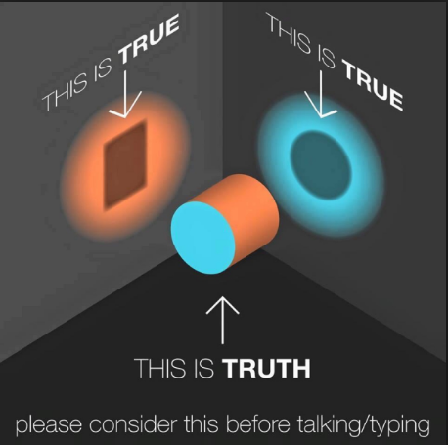
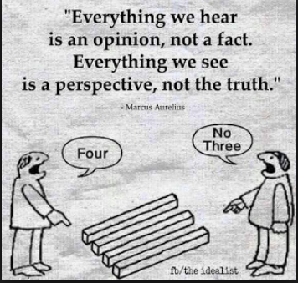
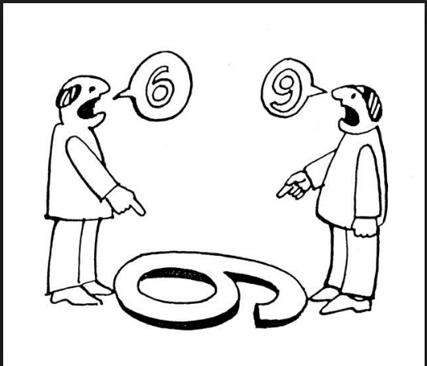
Perspective

Slide 148
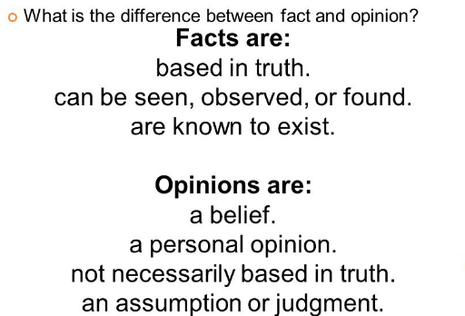
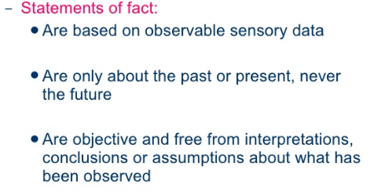
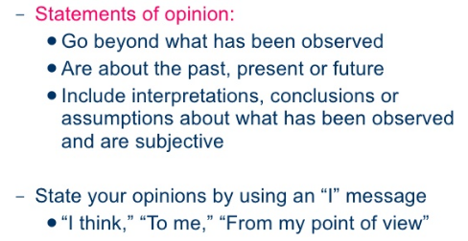
Fact vs Opinion(Assumption, Belief)

Slide 149
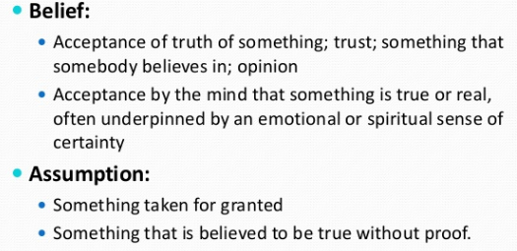
Assumption vs Belief

Slide 150
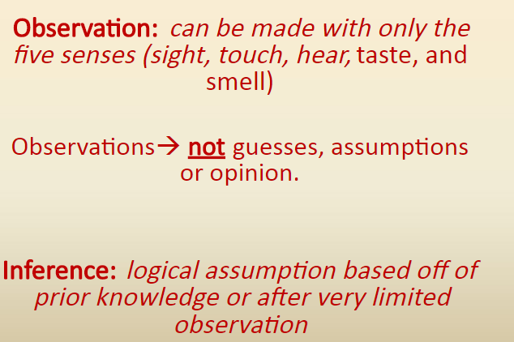
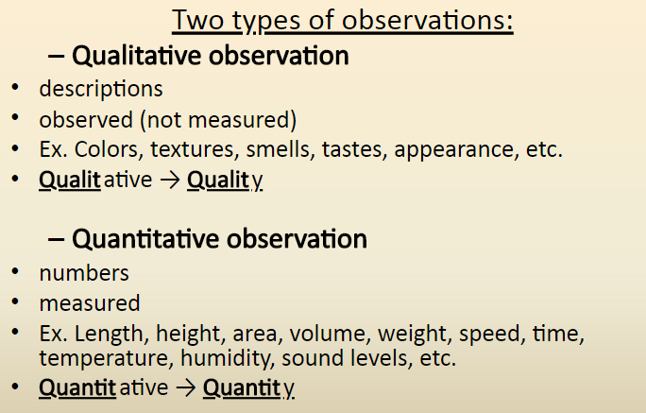
Observation(Perception) vs Inference

Slide 151
Computability
Computability
Computability refers to whether of not in principle it is possible to evaluate f(n) by following a set of instructions.
We are not for the moment worried if this computation requires 1,000,000 or more consecutive steps.
The Entscheidungsproblem (Decision problem) asks for an algorithm that takes as input a statement of a first-order logic and answers “Yes” or “No” according to whether the statement is universally valid (valid in every structure satisfying the axioms).
An algorithm to ask whether something is true. Is it computable ?
Turing Machine & Lambda Calculus – two mathematical ways to ask question about “Computability”

Slide 152
Lambda Calculus

Slide 153
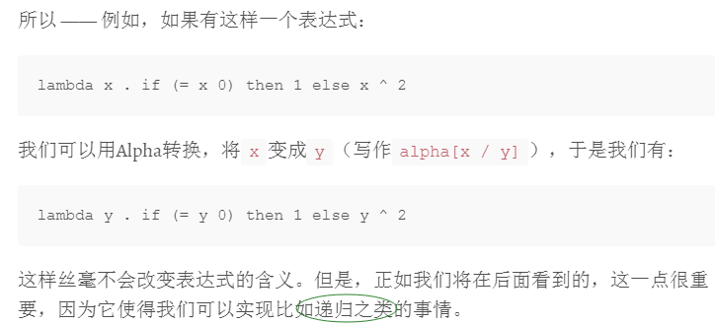
Lambda演算只有两条真正的法则：称为Alpha和Beta
Alpha转换
Alpha是一个重命名操作; 基本上就是说，变量的名称是不重要的：给定Lambda演算中的任意表达式，我们可以修改函数参数的名称，只要我们同时修改函数体内所有对它的自由引用。

Slide 154
Lambda演算只有两条真正的法则：称为Alpha和Beta
Beta规约
Beta规约才是精彩的地方：这条规则使得Lambda演算能够执行任何可以由机器来完成的计算。
Beta基本上是说，如果你有一个函数应用，你可以对这个函数体中和对应函数标识符相关的部分做替换，替换方法是把标识符用参数值替换。这听起来很费解，但是它用起来却很容易。
假设我们有一个函数应用表达式：“ (lambda x . x + 1) 3 “。所谓Beta规约就是，我们可以通过替换函数体（即“x + 1”）来实现函数应用，用数值“3”取代引用的参数“x”。于是Beta规约的结果就是“3 + 1”。

Slide 155
Ambiguity - A fundamental problem for understanding language
Outline
1. Introduction
2. Why is ambiguity a problem?
3. Local vs. global ambiguity
4. Types of ambiguity
4.1. Categorial ambiguity
4.2. Word sense ambiguity
4.3. Structural ambiguity
4.4. Referential ambiguity
4.5. Ellipsis
5. Serious problems to overcome

Slide 156
1. Introduction : why ambiguity?
For some reason, we have found it valuable to use a highly ambiguous form of natural communication between us.
Why do you think this is?

Slide 157
1. Introduction
For some reason, we have found it valuable to use a highly ambiguous form of natural communication between us.
Why do you think this is?
to be polite?
evolution of language from many other source languages
evolution of language in different places in the same country
Notice how jokes often depend on ambiguity. We are lead down the "garden path" to one meaning, and at the end find we were wrong all along. (e.g. Hunters call to ambulance). We seem to like to be surprised sometimes. Why might that be?
could it be that when we were learning a language as a child we had to sort ambiguity out and it takes us back to that time?
or perhaps we just like surprises

Slide 158
2. Why is ambiguity a problem?
Search space increased: combinatorial explosion
Basically ambiguity increases the range of possible interpretations of natural language, and a computer has to find a way to deal with this.
Suppose each word in a 10 word sentence could have 3 interpretations. The number of interpretations of the whole sentence is going to be:
3*3*3*3*3*3*3*3*3*3 = 59049
How many possible sentences are there in English?

Slide 159
2. Why is ambiguity a problem?
How many possible sentences are there in English?
More than there are atoms in the universe! (think “the big round green soft rubber ball…)
Due to syntactic / semantic / pragmatic ambiguity the actual number of possible interpretations will be huge.
To attempt to resolve all these interpretations becomes impossible in a reasonable time.
We need some knowledge to reduce the search space.

Slide 160
3. Local vs. global ambiguity
Global ambiguity
"I know more beautiful women than Kate"
(what are 2 possible meanings here)

Slide 161
3. Local vs. global ambiguity
Global ambiguity
"I know more beautiful women than Kate"
(what are 2 possible meanings here)
Local ambiguity
" although she knows quite a lot."
Local ambiguity means that part of a sentence can have more than 1 interpretation, but not the whole sentence.
Global ambiguity means that the whole sentence can have more than 1 interpretation.

Slide 162
3. Local vs. global ambiguity
Local ambiguity can sometimes be resolved by syntactic analysis
The old train.....
......the young.
Finish the sentence another way
The old train.....

Slide 163
3. Local vs. global ambiguity
Local ambiguity can sometimes be resolved by syntactic analysis
The old train.....
......the young.
.....left the station.
Here syntax can tell us that TRAIN must be a verb in sentence 1.
Global ambiguity needs semantic / pragmatic analysis
"I saw the Grand Canyon flying to New York"
"I saw a Boeing 747 flying to New York"
Here we know the meaning of the two sentences because we know what can and cannot fly. There may be funny circumstances though.
"I saw the Grand Canyon flying to New York. Take some of this and you will too!"

Slide 164
4. Types of ambiguity
Categorial ambiguity
More than one terminal symbol for a word
An exercise ….
Write 3 sentences using the word TIME as a noun, verb and adjective

Slide 165
4.1 Types of ambiguity : Categorial ambiguity
Write 3 sentences using the word TIME as a noun, verb and adjective
Noun : "Time is money"
Verb: "Time me on the last lap"
Adjective: "Time travel is not likely in my life time"
Solution?
Syntactic analysis can help to identify the correct terminal
But what about...
"Time flies like an arrow"
There are supposed to be 5 parses for this sentence, with TIME being used as a noun, verb and adjective!

Slide 166
4.2 Types of ambiguity: Word sense ambiguity
Word sense ambiguity
Word has one terminal symbol but can refer to different concepts
An exercise
Write 3 sentences using the word CHARGED with different meanings

Slide 167
4.2 Types of ambiguity: Word sense ambiguity
Write 3 sentences using the word CHARGED with different meanings
Electrical : "The battery was charged with jump leads"
Legal: "The thief was charged by PC Smith"
Responsibility: "The lecturer was charged with student recruitment"
Solution?
Syntactic analysis can help:
charged with
charged by
Semantic analysis can help:
"jump leads" and "student recruitment" are not offences (yet)
But what about...
"I saw her run to the bank"
We might use frequency of use if we had such data.

Slide 168
4.3 Types of ambiguity: Structural ambiguity
Structural ambiguity
More than parse for a sentence
An exercise
What can you eat if you are told in the refectory
"You can have peas and beans or carrots with the set meal".

Slide 169
4.3 Types of ambiguity: Structural ambiguity
An exercise
What can you eat if you are told in the refectory
"You can have peas and beans or carrots with the set meal".
[peas] and [beans or carrots]
[peas and beans] or [carrots]
This is known as co-ordinate attachment.

Slide 170
4.3 Types of ambiguity: Structural ambiguity
Another exercise
What are you being asked to do in …
"Put the box on the table by the window in the kitchen".

Slide 171
4.3 Types of ambiguity: Structural ambiguity
What are you being asked to do in …
"Put the box on the table by the window in the kitchen".
Put the box (a specific box - the one on the table by the window) in the kitchen.
Put the box on the table ( a specific table - by the window in the kitchen).etc!
This is known as prepositional attachment.

Slide 172
4.3 Types of ambiguity: Structural ambiguity
Solution?
Speech uses intonation and pauses to disambiguate
Writing uses punctuation (e.g.. commas) to disambiguate
But what about...
"I saw the boy on the hill with a telescope"
Here there are no commas, no pauses in speech (probably) so we need a model of the world to help us know where I am , and where the boy is. Are they are some distance apart? How many boys are on the hill (so we need to differentiate between them)?

Slide 173
4.4 Types of ambiguity : Referential ambiguity
Referential ambiguity
More than one object is being referred to by a noun phrase.
An exercise
What can THEY refer to in: "After THEY finished the exam the students and lecturers left."

Slide 174
4.4 Types of ambiguity : Referential ambiguity
What can THEY refer to in: "After THEY finished the exam the students and lecturers left."
Students only? Lecturers only? Both?
Solutions?
Expected situations (maybe using frames):
"John gave Mark a present and he said thanks"
Syntax can identify the head (main) noun phrase. Reference to this is more likely.
"The director fired the worker. He was known to be aggressive."
Close reference is preferred
"Sue gave Lisa a coat because she was cold"

Slide 175
4.4 Types of ambiguity : Referential ambiguity
But what about...
"Sue and Lisa gave John and Mark some grotesque horror face masks because they liked them."
Do we assume that THEM refers to John & Mark? Could be but perhaps too obvious. After all we don't really need to say that we like someone if we give something to them. Perhaps we need Grice's Maxims to help here.

Slide 176
4.5 Types of ambiguity: Ellipsis
Ellipsis
Incomplete sentence where missing item is not clear
An exercise
Give 3 interpretations for "Peter worked hard and passed the exam. Kevin too"

Slide 177
4.5 Types of ambiguity: Ellipsis
Give 3 interpretations for "Peter worked hard and passed the exam. Kevin too"
Kevin worked hard
Kevin passed the exam
Kevin did both
Solutions?
Syntactic analysis can help to identify similar structures
"The dog chased a mouse. A cat too."
"The dog chased a mouse. THE cat too."
Semantic analysis can help to identify similarities
"Did you find the paper in the drawer" "Yes"
"The pencils?"
"The cupboard?"

Slide 178
4.5 Types of ambiguity : Ellipsis
But what about...
"Peter worked hard and passed the exam. Kevin too"
The solutions above still don't let us know what the meaning is here. We might assume that it is both, or we may have to know Kevin!

Slide 179
5. Serious problems to overcome
Syntax and semantics alone are often not enough.
Imagine John is reading a local paper. On the front page it has a "Stop Press" that Sue can read. It says "Terminator 9 taken off at Roxy tonight. Replaced by 101 Dalmations 3 for 1 night only" John is reading the entertainment section inside the paper, and without looking at the front page asks the question. He asks:
" Have you seen the film at the Roxy tonight?" Which film?
The one John believes is on at the Roxy tonight
The one Sue believes is on at the Roxy tonight
The one John believes Sue believes is on at the Roxy tonight
The one Sue thinks John believes Sue believes is on at the Roxy tonight
etc….

Slide 180
Conclusions
For most free natural language processing we really need a model of the world.
Language is really just a pointer to meaning, with most meaning being understood without words.
Imagine saying "Have you seen the film that Sue thinks John believes Sue believes is on at the Roxy tonight?"
This means a computer has to have some common sense, or a model of the world as used by us.
This is a cultural phenomenon. When we learn a foreign language we need to learn about the culture too.
How do you think a computer can be taught common sense?

Slide 181
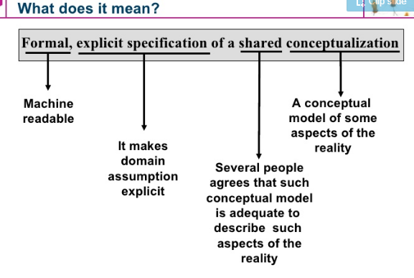
Ontology defintion

Slide 182

A simple ontology

Slide 183


Slide 184



Slide 185


Slide 186


Slide 187



Slide 188


Slide 189



Slide 190


Slide 191


